Slide 1
The Network Layer – Part 5

Slide 2
Contents
OSPF—The Interior Gateway Routing Protocol (Section 5.6.4)
BGP—The Exterior Gateway Routing Protocol (Section 5.6.5)
IPv6 (Section 5.6.8)

Slide 3
Interconnected ASes
3c
3a
2c
3b
2a
AS3
1c
AS2
1a
1b
2b
1d
AS1
Forwarding table is configured by both intra- and inter-AS routing algorithm
  Intra-AS sets entries for internal dests
  Inter-AS & Intra-As sets entries for external dests
Intra-AS
Routing
algorithm
Inter-AS
Routing
algorithm
Forwarding
table
From slides of Computer Networking course, by Prof. J. Kurose
Notes:
AS1里要形成路由表，用OSPF协议得到的路由信息是AS1子网内的所有的计算机对应的路由信息
假设发送包的目的地址是AS2的中的2c，运行OSPF协议是得不到目的地址的IP的，即IP包转不出去。此时需要用到子网间的路由

Slide 4
Routing in the Internet
Interior Gateway Protocol
  RIP(Routing Information Protocol) : distance vector protocol based on the Bellman-Ford algorithm
  OSPF(Open Shortest Path First):
Exterior Gateway Protocol
  BGP

Slide 5
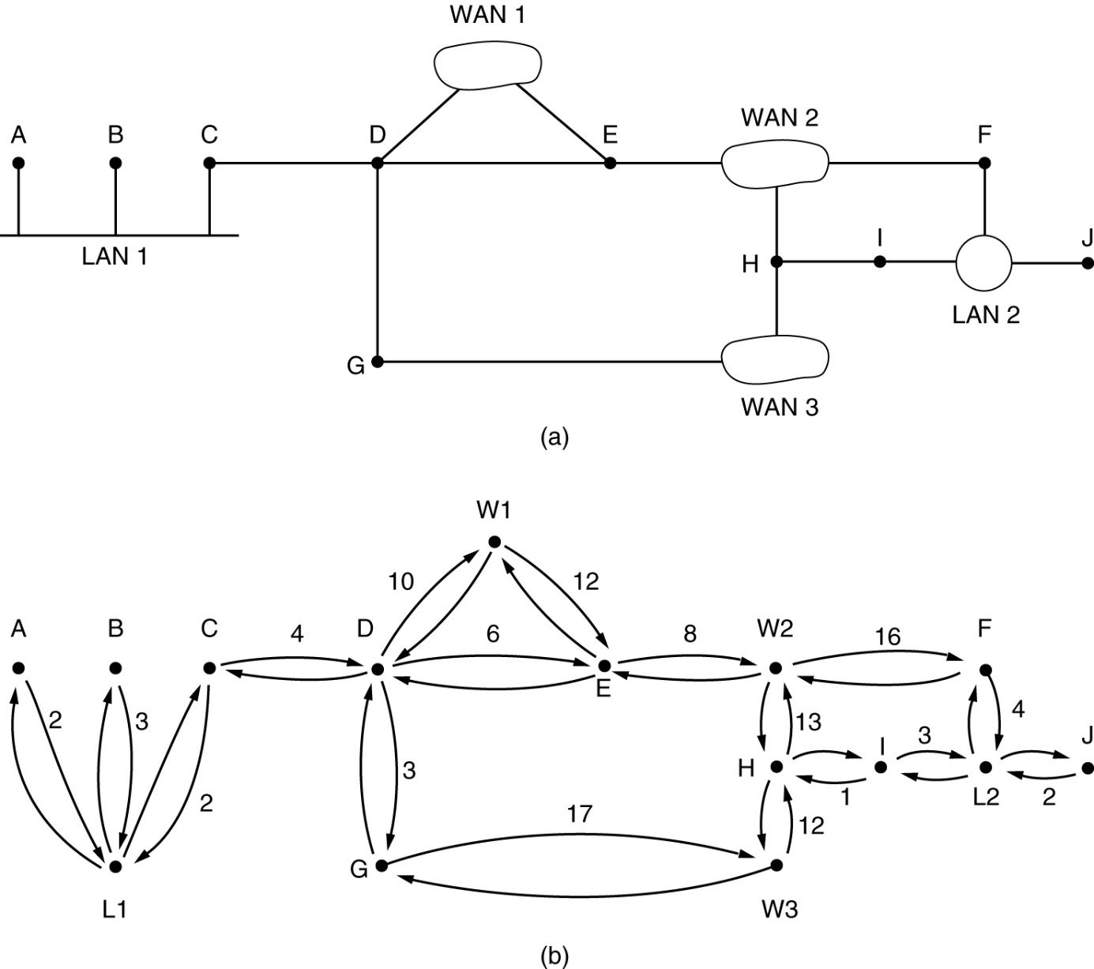
OSPF – Open Shortest Path First
The Interior Gateway Routing Protocol
(a) An autonomous system. (b) A graph representation of (a).

Slide 6
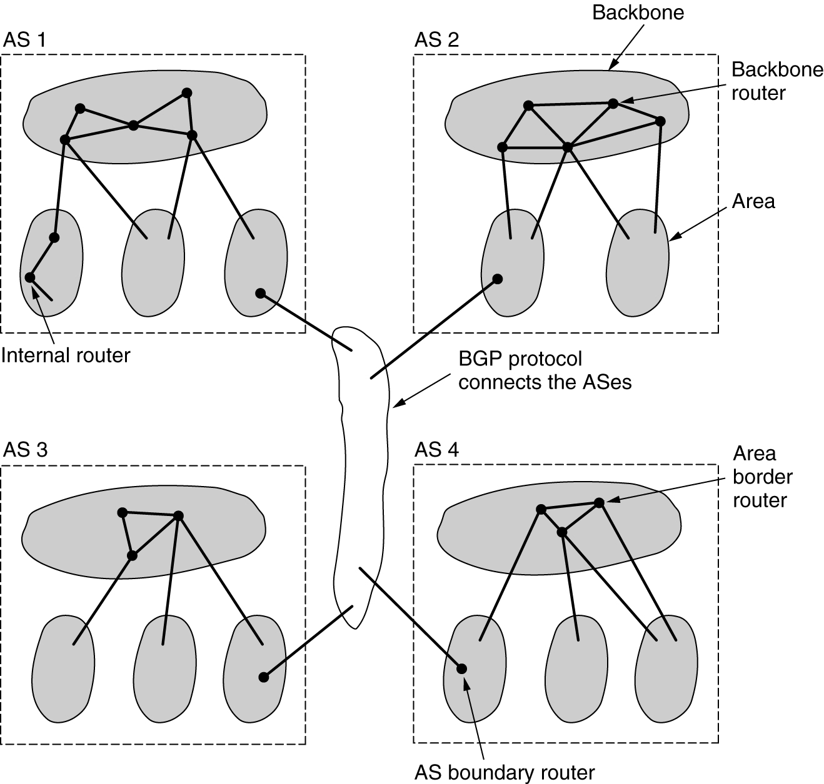
OSPF (2)
The relation between ASes, backbones, and areas in OSPF.

Slide 7
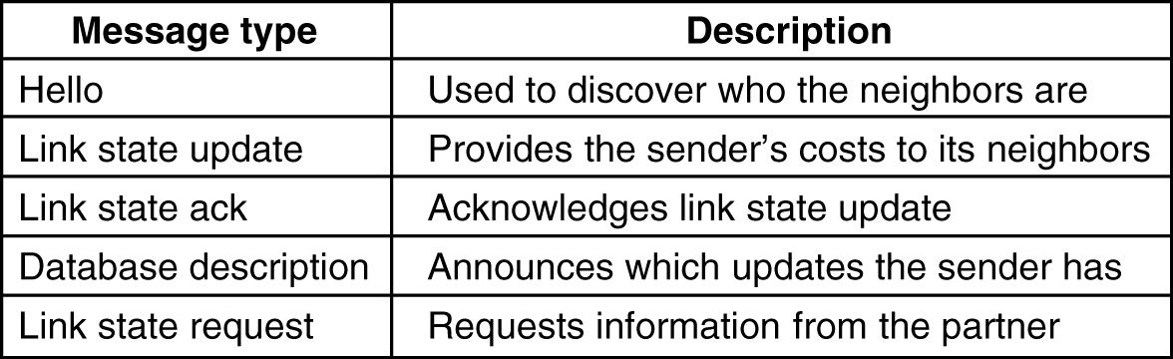
OSPF (3)
5-66
The five types of OSPF messages.

Slide 8
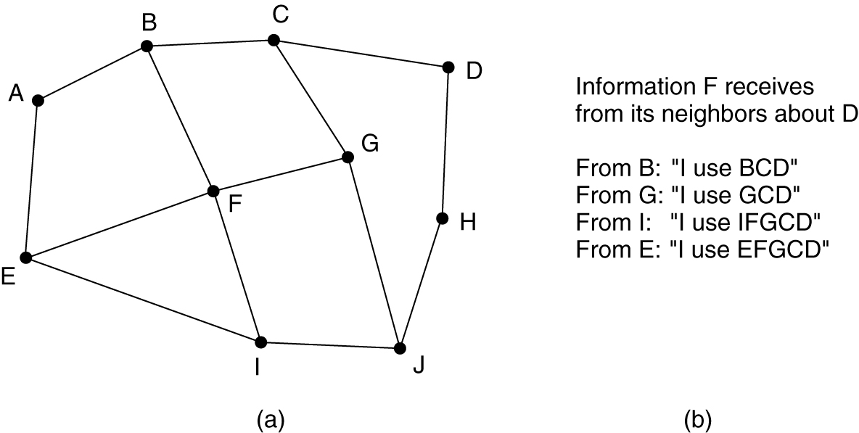
BGP – Border Gateway Protocol
The Exterior Gateway Routing Protocol
(a) A set of BGP routers. (b) Information sent to F.

Slide 9
BGP basics
Pairs of routers (BGP peers) exchange routing info over semi-permanent TCP connections: BGP sessions
Note that BGP sessions do not correspond to physical links.
When AS2 advertises a prefix to AS1, AS2 is promising it will forward any datagrams destined to that prefix towards the prefix.
  AS2 can aggregate prefixes in its advertisement
3c
3a
2c
3b
2a
AS3
2b
1c
AS2
1a
1b
AS1
1d
eBGP session
From slides of Computer Networking course, by Prof. J. Kurose
iBGP session

Slide 10
Inter-AS tasks
Suppose router in AS1 receives datagram for which dest is outside of AS1
  Router should forward packet towards one of the gateway routers, but which one?
AS1 needs:
to learn which dests are reachable through AS2 and which through AS3
to propagate this reachability info to all routers in AS1
Job of inter-AS routing!
3c
3a
2c
3b
2a
AS3
2b
1c
AS2
1a
1b
1d
AS1
From slides of Computer Networking course, by Prof. J. Kurose

Slide 11
Example: Setting forwarding table in router 1d
Suppose AS1 learns from the inter-AS protocol that subnet x is reachable from AS3 (gateway 1c) but not from AS2.
Inter-AS protocol propagates reachability info to all internal routers.
Router 1d determines from intra-AS routing info that its interface I is on the least cost path to 1c.
Puts in forwarding table entry (x,I).
From slides of Computer Networking course, by Prof. J. Kurose

Slide 12
Example: Choosing among multiple ASes
Now suppose AS1 learns from the inter-AS protocol that subnet x is reachable from AS3 and from AS2.
To configure forwarding table, router 1d must determine towards which gateway it should forward packets for dest x.
This is also the job on inter-AS routing protocol!
Hot potato routing: send packet towards closest of two routers.
Use routing info
from intra-AS
protocol to determine
costs of least-cost
paths to each
of the gateways
Determine from
forwarding table the
interface I that leads
to least-cost gateway.
Enter (x,I) in
forwarding table
Learn from inter-AS
protocol that subnet
x is reachable via
multiple gateways
Hot potato routing:
Choose the gateway
that has the
smallest least cost
From slides of Computer Networking course, by Prof. J. Kurose

Slide 13
BGP messages
BGP messages exchanged using TCP.
BGP messages:
  OPEN: opens TCP connection to peer and authenticates sender
  UPDATE: advertises new path (or withdraws old)
  KEEPALIVE keeps connection alive in absence of UPDATES; also ACKs OPEN request
  NOTIFICATION: reports errors in previous msg; also used to close connection
From slides of Computer Networking course, by Prof. J. Kurose

Slide 14
BGP route selection
Router may learn about more than 1 route to some prefix. Router must select route.
Elimination rules:
  Local preference value attribute: policy decision
  Shortest AS-PATH
  Closest NEXT-HOP router: hot potato routing
  Additional criteria
From slides of Computer Networking course, by Prof. J. Kurose

Slide 15
IPv6
Major goals of IPv6:
  Support billions of hosts, even with inefficient address space allocation
  Reduce the size of the routing tables
  Simplify the protocol, to allow routers to process packets faster
  Provide better security (authentication and privacy) than current IP
  Pay more attention to type of service, particularly for real-time data
  Aid multicasting by allowing scopes to be specified
  Make it possible for a host to roam without changing its address
  Allow the protocol to evolve in the future.
  Permit the old and new protocols to coexist for years

Slide 16
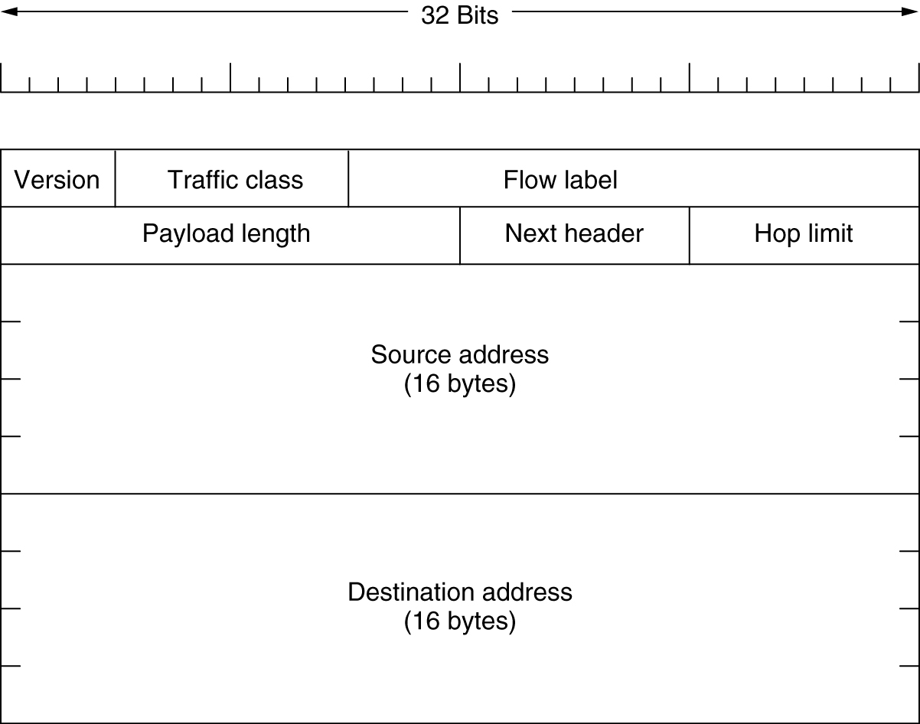
The Main IPv6 Header
The IPv6 fixed header (required).

Slide 17
Summary
IGP
  OSPF
EGP
  BGP
IPv6

